Slide 1


Control Systems (CS)
Lecture-12-13
Time Domain Analysis of 1st Order Systems

Slide 2
Introduction
In time-domain analysis the response of a dynamic system to an input is expressed as a function of time.
It is possible to compute the time response of a system if the nature of input and the mathematical model of the system are known.
Usually, the input signals to control systems are not known fully ahead of time.
For example, in a radar tracking system, the position and the speed of the target to be tracked may vary in a random fashion.
It is therefore difficult to express the actual input signals mathematically by simple equations.

Slide 3
Standard Test Signals
The characteristics of actual input signals are a sudden shock, a sudden change, a constant velocity, and constant acceleration.
The dynamic behavior of a system is therefore judged and compared under application of standard test signals – an impulse, a step, a constant velocity, and constant acceleration.
Another standard signal of great importance is a sinusoidal signal.

Slide 4
Standard Test Signals
Impulse signal
The impulse signal imitate the sudden shock characteristic of actual input signal.
If A=1, the impulse signal is called unit impulse signal.
δ(t)
A
0
t

Slide 5
Standard Test Signals
Step signal
The step signal imitate the sudden change characteristic of actual input signal.
If A=1, the step signal is called unit step signal
u(t)
A
0
t

Slide 6
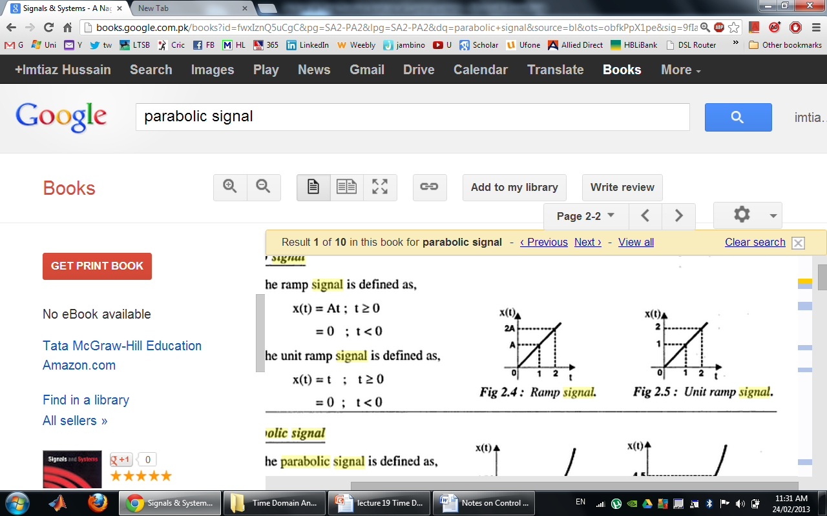
Standard Test Signals
Ramp signal
The ramp signal imitate the constant velocity characteristic of actual input signal.
If A=1, the ramp signal is called unit ramp signal
r(t)
0
t
r(t)
ramp signal with slope A
r(t)
unit ramp signal

Slide 7
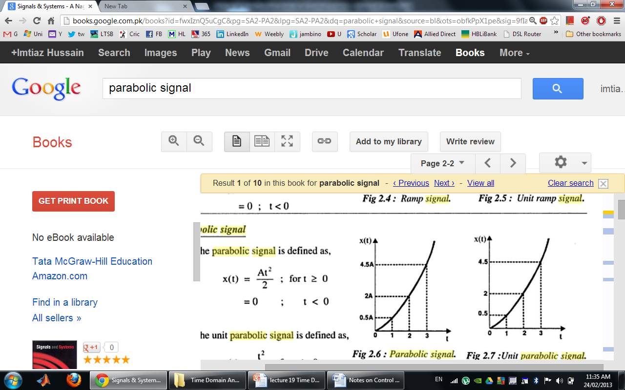
Standard Test Signals
Parabolic signal
The parabolic signal imitate the constant acceleration characteristic of actual input signal.
If A=1, the parabolic signal is called unit parabolic signal.
p(t)
0
t
p(t)
parabolic signal with slope A
p(t)
Unit parabolic signal

Slide 8
Relation between standard Test Signals
Impulse
Step
Ramp
Parabolic

Slide 9
Laplace Transform of Test Signals
Impulse
Step

Slide 10
Laplace Transform of Test Signals
Ramp
Parabolic

Slide 11
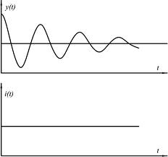
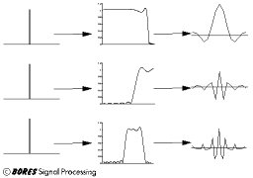
Time Response of Control Systems
Time response of a dynamic system response to an input expressed as a function of time.
System
The time response of any system has two components
Transient response
Steady-state response.

Slide 12
Time Response of Control Systems
When the response of the system is changed form rest or equilibrium it takes some time to settle down.
Transient response is the response of a system from rest or equilibrium to steady state.
The response of the system after the transient response is called steady state response.
Steady State Response
Transient Response

Slide 13
Time Response of Control Systems
Transient response depend upon the system poles only and not on the type of input.
It is therefore sufficient to analyze the transient response using a step input.
The steady-state response depends on system dynamics and the input quantity.
It is then examined using different test signals by final value theorem.

Slide 14
Introduction
The first order system has only one pole.
Where K is the D.C gain and T is the time constant of the system.
Time constant is a measure of how quickly a 1st order system responds to a unit step input.
D.C Gain of the system is ratio between the input signal and the steady state value of output.

Slide 15
Introduction
The first order system given below.
D.C gain is 10 and time constant is 3 seconds.
And for following system
D.C Gain of the system is 3/5 and time constant is 1/5 seconds.

Slide 16
Impulse Response of 1st Order System
Consider the following 1st order system
δ(t)
1
0
t

Slide 17
Impulse Response of 1st Order System
Re-arrange following equation as
In order represent the response of the system in time domain we need to compute inverse Laplace transform of the above equation.

Slide 18
Impulse Response of 1st Order System
If K=3 and T=2s then

Slide 19
Step Response of 1st Order System
Consider the following 1st order system
In order to find out the inverse Laplace of the above equation, we need to break it into partial fraction expansion
Forced Response
Natural Response

Slide 20
Step Response of 1st Order System
Taking Inverse Laplace of above equation
Where u(t)=1
When t=T

Slide 21
Step Response of 1st Order System
If K=10 and T=1.5s then

Slide 22
Step Response of 1st Order System
If K=10 and T=1, 3, 5, 7

Slide 23
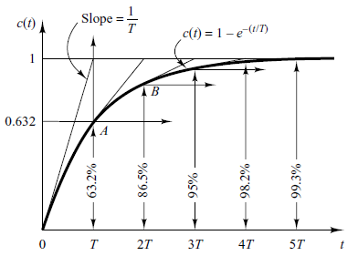
Step Response of 1st order System
System takes five time constants to reach its final value.

Slide 24
Step Response of 1st Order System
If K=1, 3, 5, 10 and T=1

Slide 25
Relation Between Step and impulse response
The step response of the first order system is
Differentiating c(t) with respect to t yields

Slide 26
Example#1
Impulse response of a 1st order system is given below.
Find out
Time constant T
D.C Gain K
Transfer Function
Step Response

Slide 27
Example#1
The Laplace Transform of Impulse response of a system is actually the transfer function of the system.
Therefore taking Laplace Transform of the impulse response given by following equation.

Slide 28
Example#1
Impulse response of a 1st order system is given below.
Find out
Time constant T=2
D.C Gain K=6
Transfer Function
Step Response
Also Draw the Step response on your notebook

Slide 29
Example#1
For step response integrate impulse response
We can find out C if initial condition is known e.g. c_{s}(0)=0

Slide 30
Example#1
If initial Conditions are not known then partial fraction expansion is a better choice

Slide 31
Ramp Response of 1st Order System
Consider the following 1st order system
The ramp response is given as

Slide 32
Ramp Response of 1st Order System
If K=1 and T=1
Unit Ramp Response
10
Unit Ramp
Ramp Response
8
c(t)
6
4
error
2
0
0
5
10
15
Time

Slide 33
Ramp Response of 1st Order System
If K=1 and T=3
Unit Ramp Response
10
Unit Ramp
Ramp Response
8
6
c(t)
4
2
error
0
0
5
10
15
Time

Slide 34
Parabolic Response of 1st Order System
Consider the following 1st order system
Therefore,
Do it yourself

Slide 35
Practical Determination of Transfer Function of 1st Order Systems
Often it is not possible or practical to obtain a system's transfer function analytically.
Perhaps the system is closed, and the component parts are not easily identifiable.
The system's step response can lead to a representation even though the inner construction is not known.
With a step input, we can measure the time constant and the steady-state value, from which the transfer function can be calculated.

Slide 36
Practical Determination of Transfer Function of 1st Order Systems
If we can identify T and K from laboratory testing we can obtain the transfer function of the system.

Slide 37
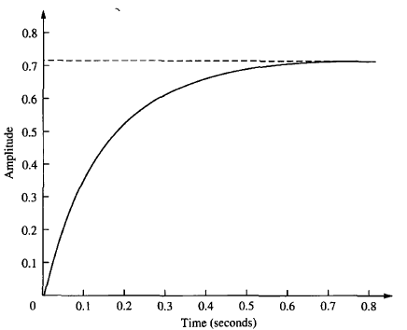
Practical Determination of Transfer Function of 1st Order Systems
For example, assume the unit step response given in figure.
K=0.72
From the response, we can measure the time constant, that is, the time for the amplitude to reach 63% of its final value.
Since the final value is about 0.72 the time constant is evaluated where the curve reaches 0.63 x 0.72 = 0.45, or about 0.13 second.
T=0.13s
Thus transfer function is obtained as:
K is simply steady state value.

Slide 38
1st Order System with a Zero
Zero of the system lie at -1/α and pole at -1/T.
Step response of the system would be:

Slide 39
1st Order System with & W/O Zero
If T>α the response will be same

Slide 40
1st Order System with & W/O Zero
If T>α the response of the system would look like

Slide 41
1st Order System with & W/O Zero
If T<α the response of the system would look like

Slide 42
1st Order System with a Zero

Slide 43
1st Order System with & W/O Zero
1st Order System Without Zero

Slide 44
Home Work
Find out the impulse, ramp and parabolic response of the system given below.

Slide 45
Example#2
A thermometer requires 1 min to indicate 98% of the response to a step input. Assuming the thermometer to be a first-order system, find the time constant.
If the thermometer is placed in a bath, the temperature of which is changing linearly at a rate of 10°min, how much error does the thermometer show?

Slide 46
PZ-map and Step Response
jω
δ
-3
-2
-1

Slide 47
PZ-map and Step Response
jω
δ
-3
-2
-1

Slide 48
PZ-map and Step Response
jω
δ
-3
-2
-1

Slide 49
Comparison

Slide 50
First Order System With Delays
Following transfer function is the generic representation of 1st order system with time lag.
Where t_{d} is the delay time.

Slide 51
First Order System With Delays
1
Unit Step
Step Response
t
t_{d}

Slide 52
First Order System With Delays

Slide 53
Examples of First Order Systems
Armature Controlled D.C Motor (L_{a}=0)
R_{a}
L_{a}
B
i_{a}
u
e_{b}
T
J
ω
V_{f}=constant

Slide 54
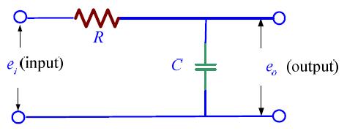
Examples of First Order Systems
Electrical System

Slide 55
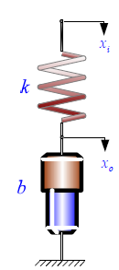
Examples of First Order Systems
Mechanical System

